Slide 1
Stock Price Prediction through LSTM
R Liu
08-29-2023

Slide 2
Introduction and Dataset Basic Info
Target: To predict the close stock price of CVS health through LSTM model.
Dataset Basic Info:
12731 records, from 02/1973 to 08/2023
Date, Open, High, Low, Close, Adj Close, Volume.
Train / Test: 11444/1272 records (former 90%/latter 10%)

Slide 3
Workflow
Connect to Google Colab
Download & Copy File
Data Exploration & Preprocessing
Establish Model & Data Loading & Transform
Define & Tuning Parameters
Model Training & Evaluation
Train-test split

Slide 4
Model Parameter & Hyper Parameter
Parameters:
INPUT_SIZE = 14, HIDDEN_SIZE = 256, NUM_LAYERS = 4, OUTPUT_SIZE = 1
BATCH_SIZE = 256, dropout=0.1, bidirectional=True
Hyper parameters
learning_rate = 0.0003, num_epochs = 450

Slide 5
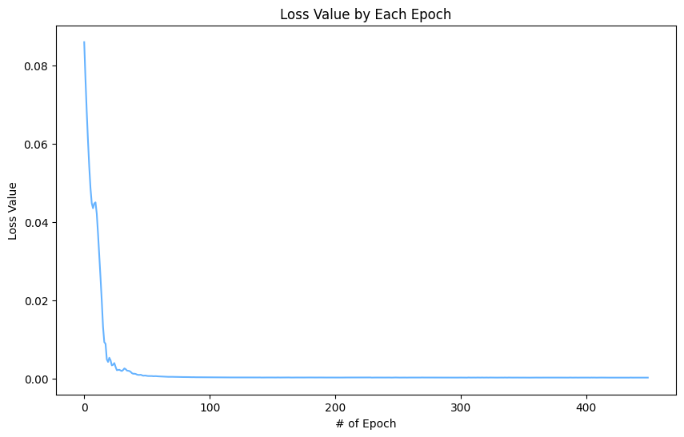
Result: Model Training
After 450 epochs, the loss value of training dropped from 0.086 to 0.000179.
While its evaluation dropped from 0.43 to 0.0022 (epoch 440).

Slide 6
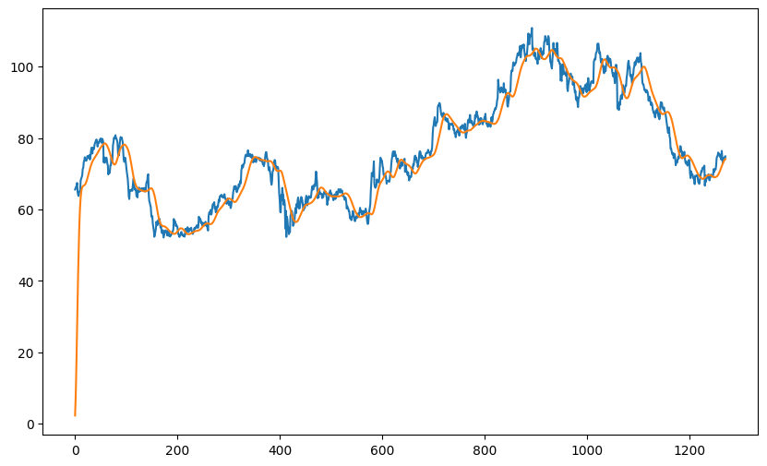
Result: Prediction on the Training Dataset
Despite the fine-tuning, the predicted value (orange) was still “lagging” a couple of days comparing to the actual value.

Slide 7
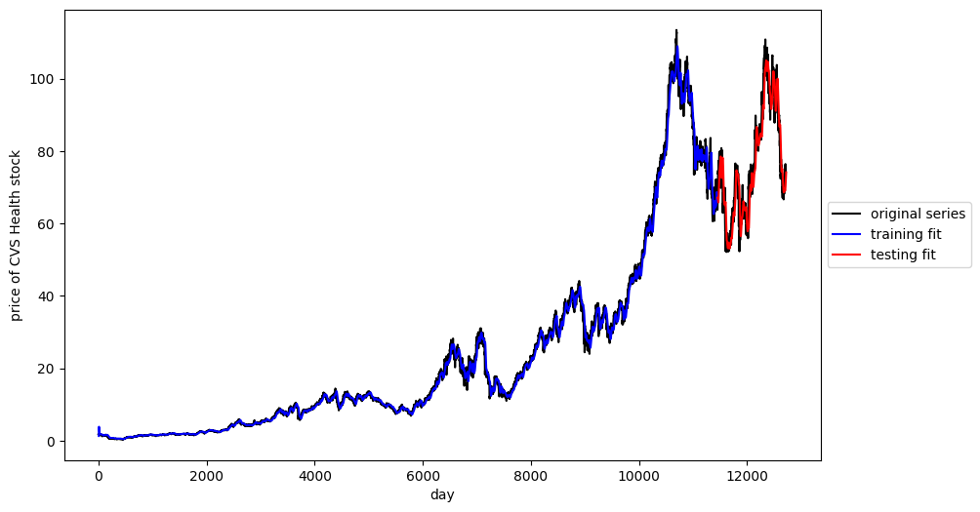
Result: Prediction on The Test Dataset
The prediction result on test dataset shows the model could fit the mid-to-long term trend despite failing to predict the short-term variance on-time.
Root of Mean Square Error (RMSE) = 5.27

Slide 8
Discussions & Conclusions
Through the usage of RNN+LSTM network within pytorch framework. I fine-tuned the model and its RMSE in test dataset was decreased from 9.22 to 5.27.
Despite its lagging prediction that is common in “stochastic” time series data prediction, it could accurately fit the overall long-term trend within a couple of day.
Therefore, it would not be a reliable approach to predict the short-time fluctration of the stock market. Instead, the LSTM model would be more competent to solve the long-run problem of the time-series data.

